Slide 1
Mobile and Embedded Computing
Lecture 3. Agent assisted coding, Flutter Widgets & UI Elements, Async vs Threads

Slide 2
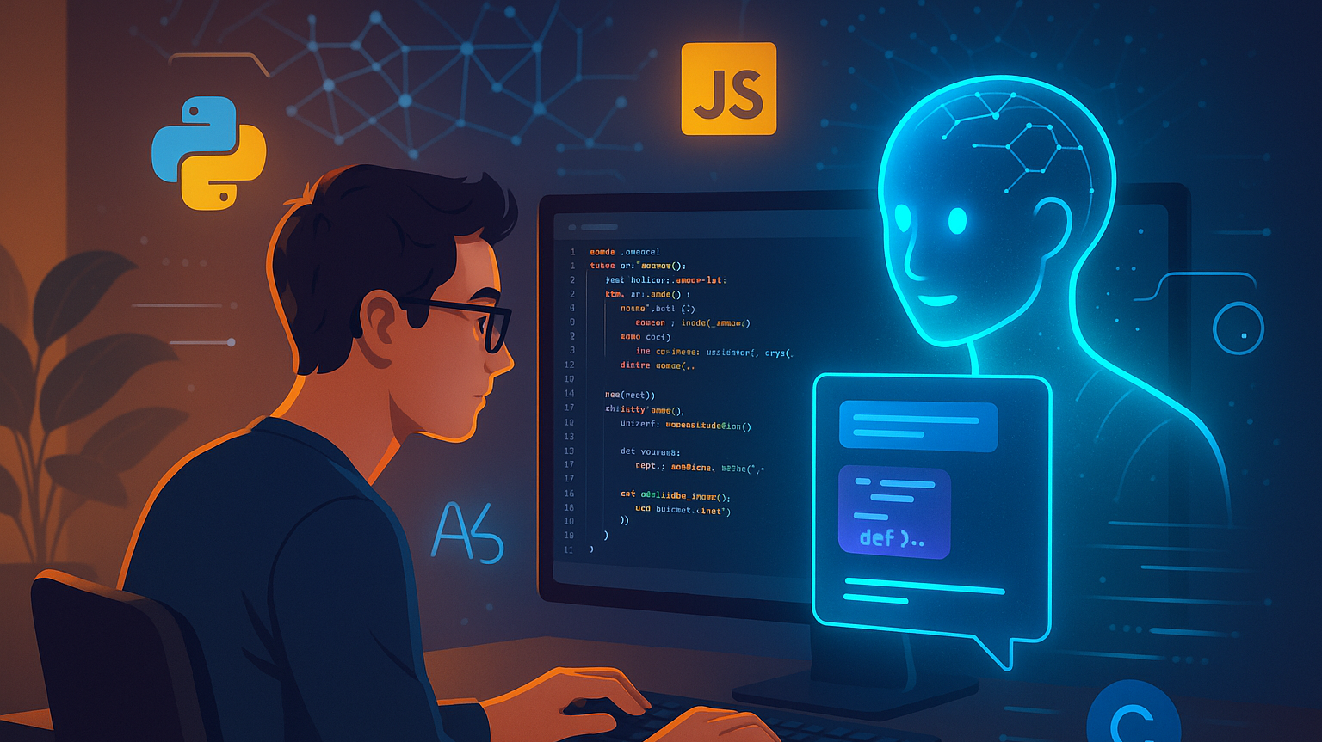
Agent Assisted Coding

Slide 3
Tools
Conversational AI Assistants (Claude, ChatGPT, Gemini)
IDE Integrations (Copilot, Windsurf Plugin, Cline, Roo)
Agentic flow oriented (Cursor, Claude Code, Gemini CLI, Windsurf, Codex, Kiro, JetBrains Junie)

Slide 4
Getting the Most Out of AI
Be specific about context
Share your tech stack, framework versions, and project structure upfront
Explain what you've already tried and what didn't work
Mention any constraints (performance requirements, browser support, dependencies)
Break complex problems into smaller pieces
Instead of "build me a full authentication system," try "help me implement JWT token validation middleware"
You can iterate and build up complexity gradually

Slide 5
Getting the Most Out of AI
Ask for explanations, not just code
Request "explain why this approach works" to actually learn
Ask about trade-offs between different solutions
Understanding the reasoning helps you modify code later
Provide error messages and stack traces
Copy the full error message, not just your interpretation
Include relevant file paths and line numbers
Share the code that's causing the issue

Slide 6
Best Practices
Always review generated code carefully
Don't blindly copy-paste without understanding what it does
Check for security issues (SQL injection, XSS, hardcoded secrets)
Verify it follows your project's conventions and style
Test everything
AI-generated code can have subtle bugs
Write tests or manually verify behavior
Edge cases are often missed

Slide 7
Best Practices
Outdated practices
AI training data has a cutoff, so newer library versions might not be reflected
Always check current documentation for your dependencies
Be skeptical of deprecated methods or patterns
Hallucinated APIs or features
AI might confidently suggest functions or packages that don't exist
Verify that imports, methods, and configuration options are real
Quick check: does it appear in the official docs?
Use MCP servers that are able to give the model latest information

Slide 8
Prompt Engineering
Be Clear and Specific
State exactly what you want rather than what you don't want
Include relevant details, constraints, and requirements upfront
Specify the desired format, length, or structure
Provide Context
Explain the purpose or use case
Share relevant background information
Define your audience or perspective
Use Examples
Show examples of desired outputs (positive examples)
Include counterexamples of what to avoid (negative examples)
Demonstrates patterns more effectively than descriptions alone

Slide 9
Prompt Engineering
Break Down Complex Tasks
Split multi-part requests into clear steps
Use numbered lists for sequential tasks
Ask for step-by-step reasoning when needed
Specify Output Format
Request specific structures (tables, bullet points, code blocks)
Ask for XML tags to organize different sections
Define tone, style, or technical level
Effective Patterns
"Act as a [role]..." for perspective-taking
"Think step-by-step" for reasoning tasks
"Before answering, consider..." for analysis
"Output in [format]" for structured responses

Slide 10
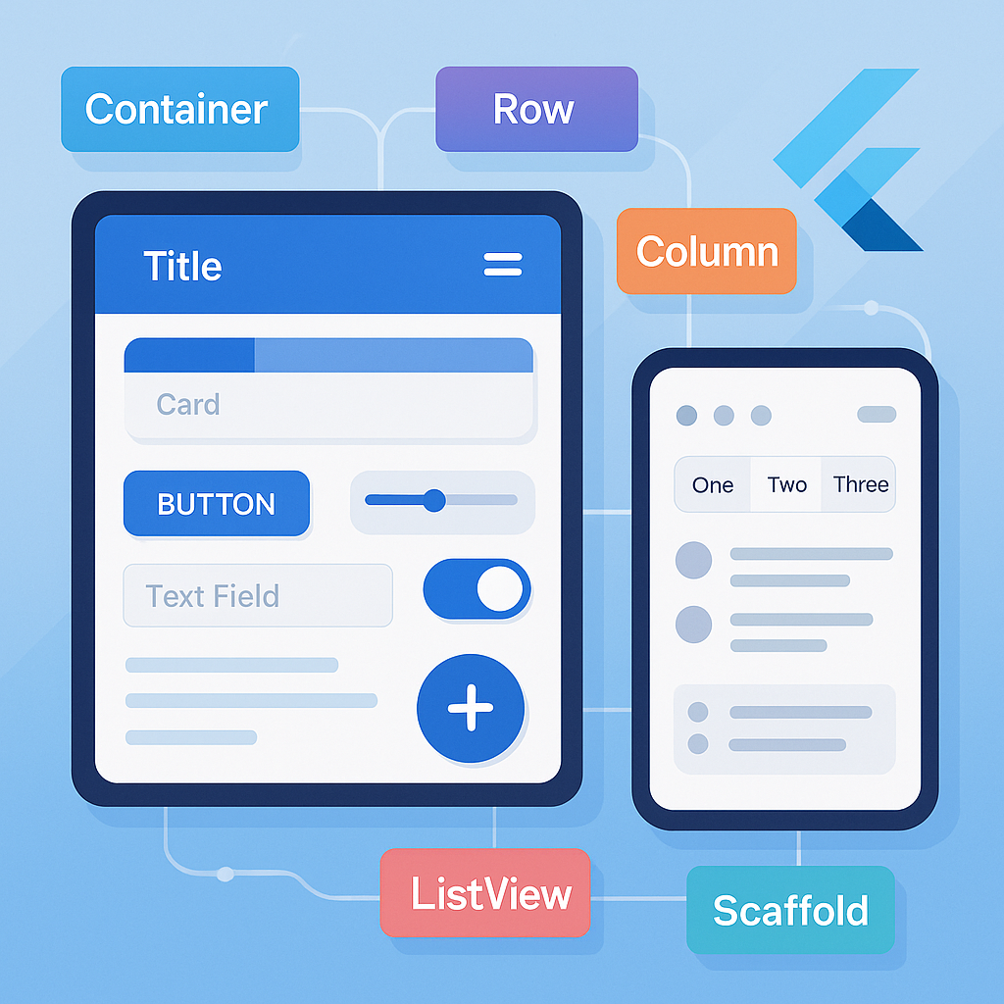
Flutter Widgets and Built in UI elements

Slide 11
Introduction to Widgets - Everything is a Widget in Flutter
In Flutter, widgets are the building blocks of the UI
A widget describes what the view should look like given its current configuration and state
Immutable descriptions of part of the user interface

Slide 12
Widget tree
Flutter apps are structured as a tree of widgets
Parent widgets contain child widgets
Root widget at the top, leaf widgets at the bottom
Example hierarchy: MaterialApp → Scaffold → Column → Text

Slide 13

Paradigm
Declarative UI
Describe WHAT the UI should look like, not HOW to build it
UI = f(state) - UI is a function of state
When state changes, Flutter rebuilds the widget tree
Contrast with imperative approach (Android/iOS traditional)

Slide 14
StatelessWidget vs StatefulWidget
StatelessWidget: Immutable, no internal state that changes
Use when UI doesn't change dynamically
Example: static text, icons, layouts
StatefulWidget: Mutable state that can change over time
Use when UI needs to respond to user interaction or data changes
Contains a State object that persists across rebuilds
Example: forms, animations, real-time data displays

Slide 15
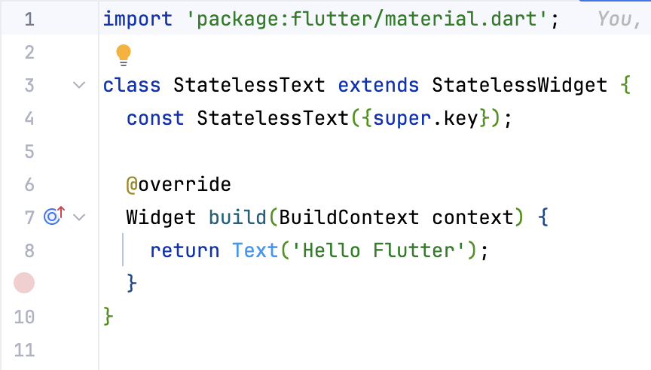
Stateless Widget

Slide 16
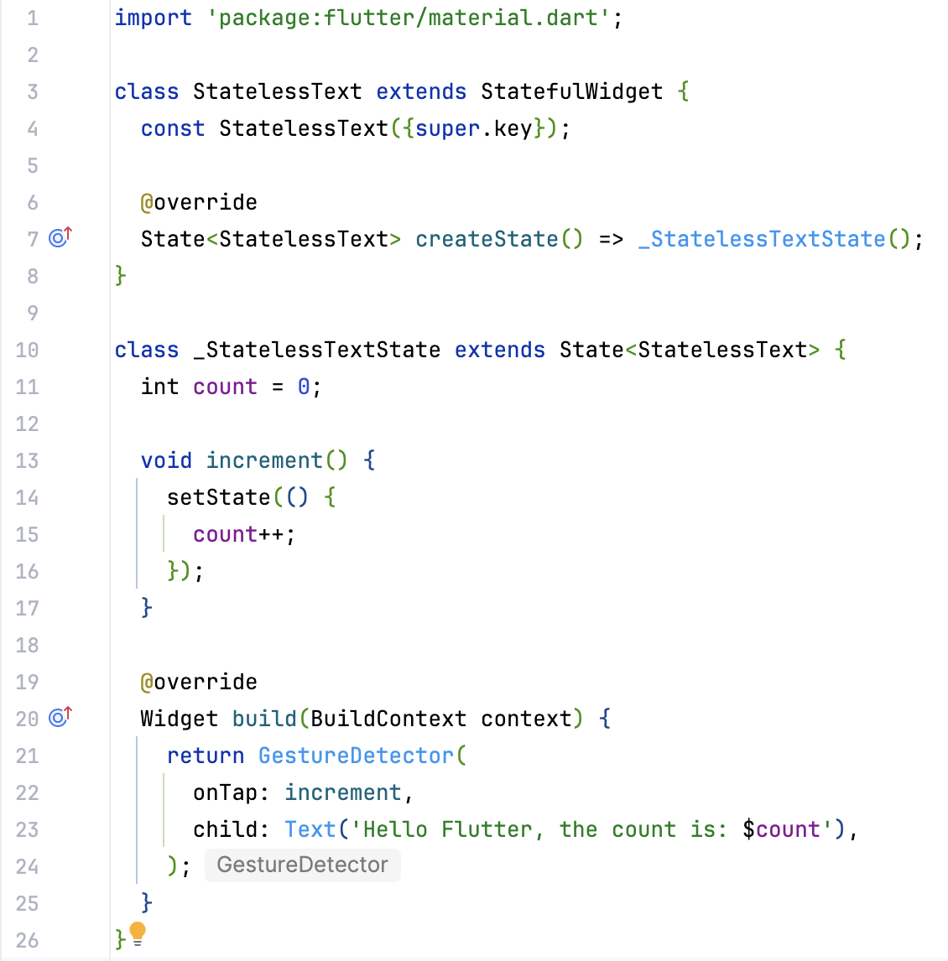
Stateful Widget

Slide 17
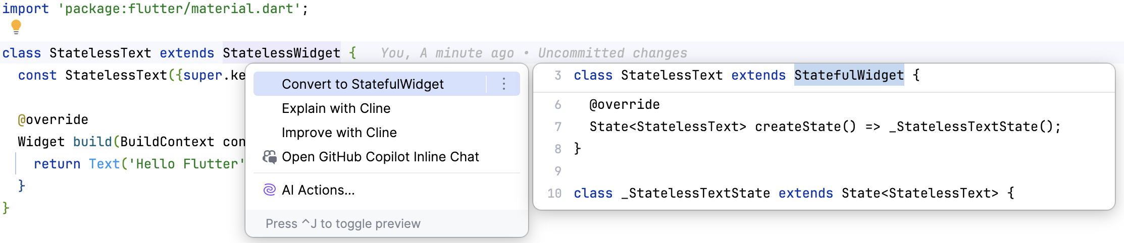
Converting Stateless Widgets to Stateful

Slide 18
Widget Categories – Layout widgets
Purpose: Arrange and position other widgets
Control spacing, alignment, and sizing
Examples:
Container: Single-child layout widget with styling
Row: Horizontal arrangement
Column: Vertical arrangement
Stack: Overlapping widgets

Slide 19
Widget Categories – Structural Widgets
Purpose: Provide app structure and navigation scaffolding
Define the overall architecture
Examples:
Scaffold: Basic material design layout structure
AppBar: Top navigation bar
Drawer: Side navigation menu
BottomNavigationBar: Bottom navigation

Slide 20
Widget Categories – Input Widgets
Purpose: Capture user input
Handle user interactions
Examples:
TextField: Text input
Button variations: ElevatedButton, TextButton
Checkbox, Radio, Switch: Boolean/option selection
Slider: Range selection

Slide 21
Widget Categories – Display Widgets
Purpose: Show content to users
Present information visually
Examples:
Text: Display text
Image: Display images
Icon: Display icons
Card: Material design card

Slide 22

Widget composition
Widgets can be combined to create complex Uis
Small, focused widgets are preferred
Reusability and maintainability through composition
You have the entire Flutter widget catalog here: https://docs.flutter.dev/ui/widgets
see s2_composition good and bad folders for examples

Slide 23
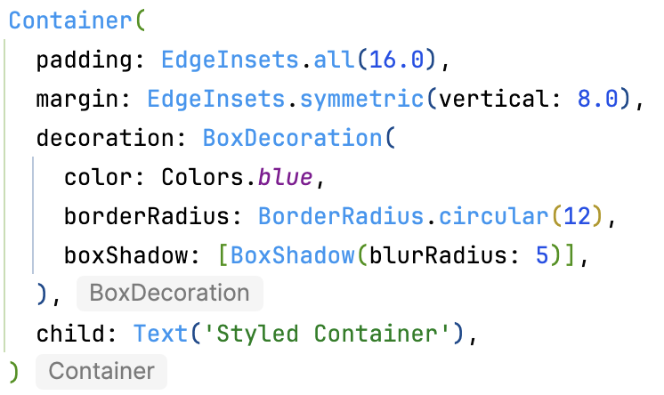
Basic Layout Widgets
Container:
Most commonly used single-child layout widget
Properties:
padding: Internal spacing (EdgeInsets)
margin: External spacing
decoration: BoxDecoration for styling (color, border, shadow, gradient)
width & height: Size constraints
alignment: Position child within container
Use case: Add padding, margins, backgrounds, borders

Slide 24
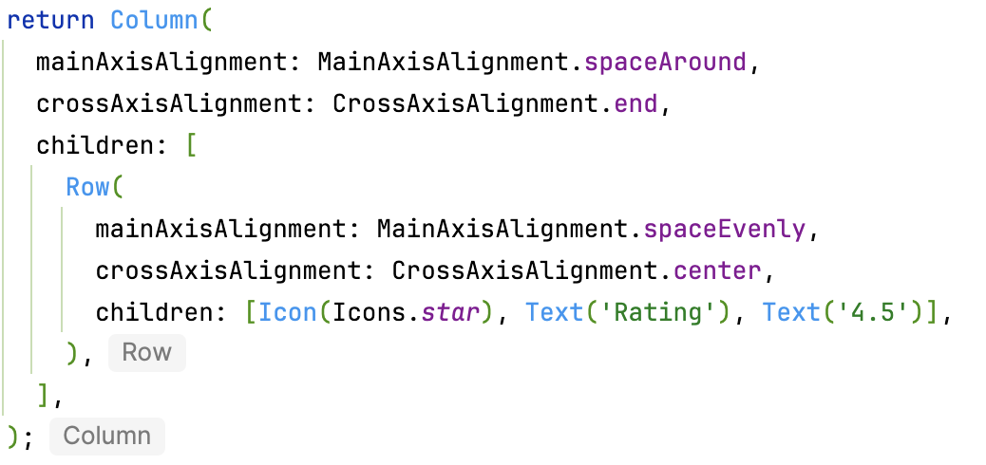
Basic Layout Widgets
Row & Column:
Multi-child layout widgets
Row: Arranges children horizontally
Column: Arranges children vertically
Key Properties:
mainAxisAlignment: Alignment along main axis (start, end, center, spaceBetween, spaceAround, spaceEvenly)
crossAxisAlignment: Alignment along cross axis (start, end, center, stretch, baseline)
mainAxisSize: min or max (how much space to occupy)

Slide 25
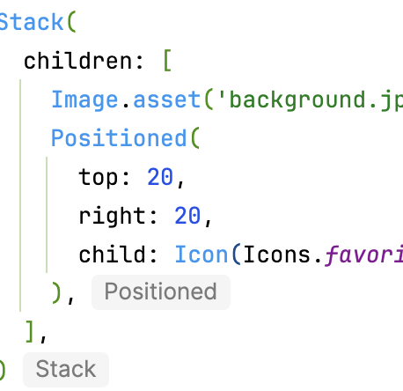
Basic Layout Widgets
Stack & Positioned:
Stack: Overlays children on top of each other
Positioned: Controls exact position within Stack
Use case: Badges, overlays, complex layered designs
Children are painted in order (first = bottom)

Slide 26
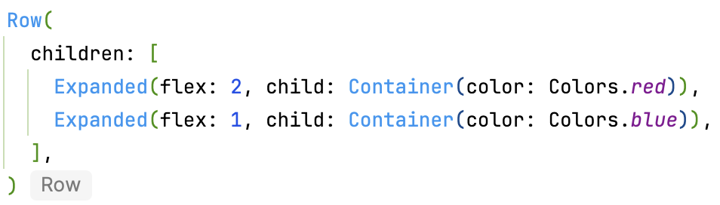
Basic Layout Widgets
Expanded & Flexible:
Control how children of Row/Column flex to fill available space
Expanded: Takes all available space
Flexible: Can take available space but can be smaller
flex property: Ratio of space to occupy (default: 1)

Slide 27
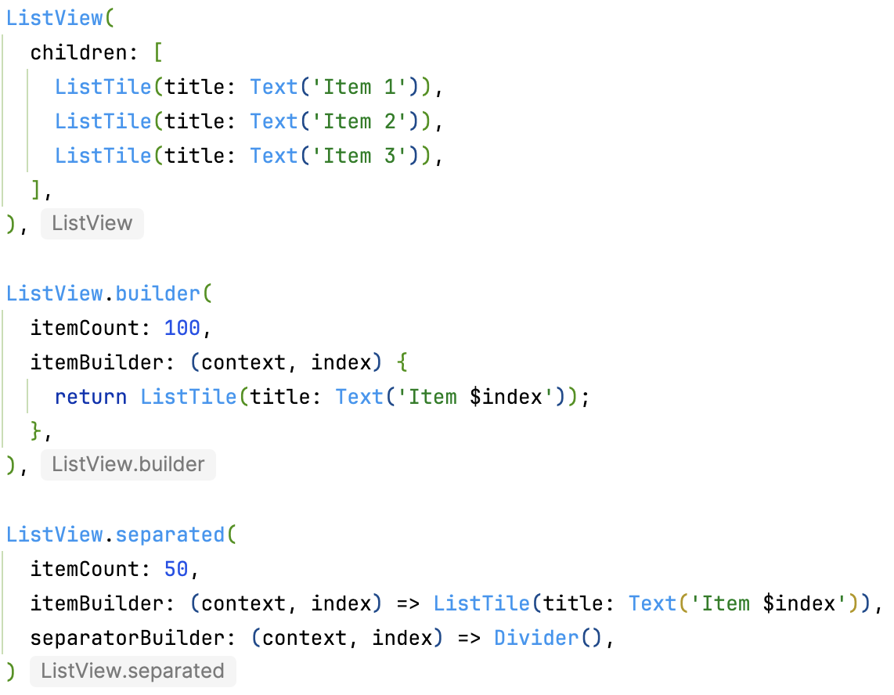
Scrolling Widgets – Making content scrollable
ListView:
Scrollable list of widgets
ListView: Fixed list of children
ListView.builder: Efficient for large lists (lazy loading)
ListView.separated: With dividers between items
Properties: padding, scrollDirection (vertical/horizontal)

Slide 28
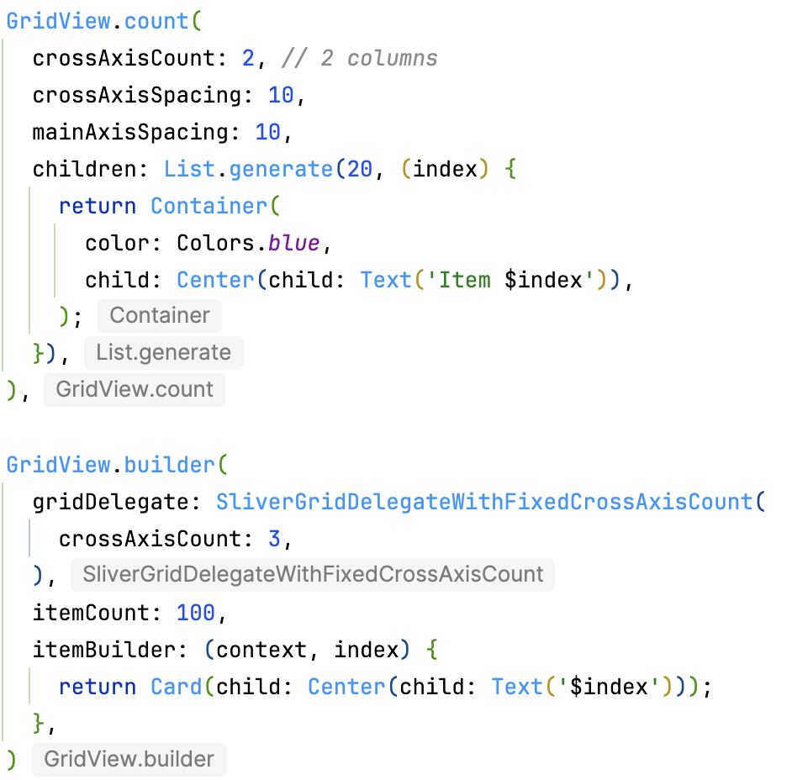
Scrolling Widgets – Making content scrollable
GridView:
Scrollable grid layout
GridView.count: Fixed number of columns
GridView.extent: Maximum cross-axis extent
GridView.builder: Efficient for large grids

Slide 29
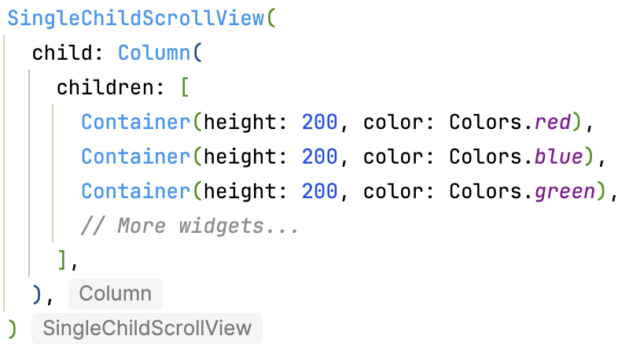
Scrolling Widgets – Making content scrollable
SingleChildScrollView:
Makes a single child scrollable
Use when you have a Column/Row that might overflow
Wraps content that doesn't fit on screen
Caution: Not efficient for large lists (use ListView instead)

Slide 30
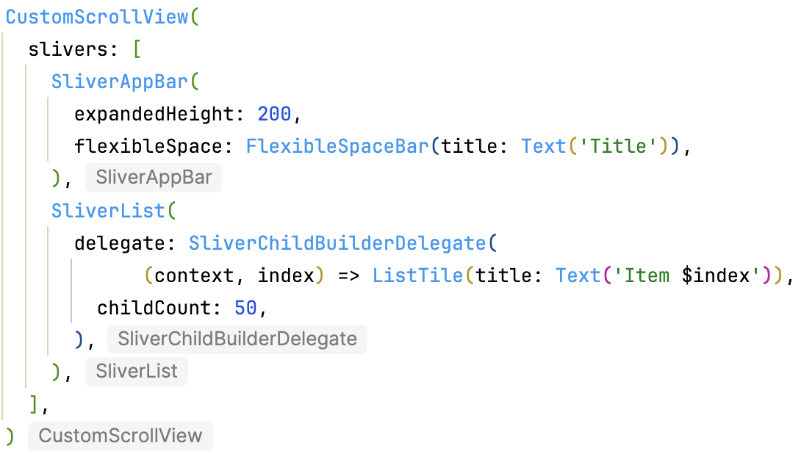
Scrolling Widgets – Making content scrollable
CustomScrollView:
Create custom scroll effects
Uses "slivers" - scrollable areas
Common slivers:
SliverAppBar: Collapsing app bar
SliverList: Scrollable list
SliverGrid: Scrollable grid

Slide 31
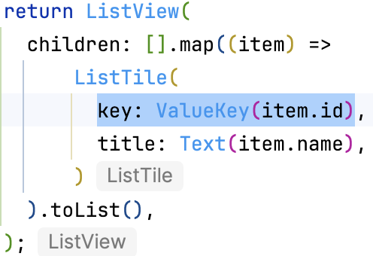
Common Widget Properties – ‘Key’
Uniquely identifies widgets in the widget tree
Used by Flutter to determine which widgets to reuse when tree changes
Types:
ValueKey: Use value to identify (e.g., ValueKey('email'))
ObjectKey: Use object reference
UniqueKey: Always creates new key
GlobalKey: Access widget from anywhere (use sparingly)
When to use: Lists with reorderable items, preserving state

Slide 32
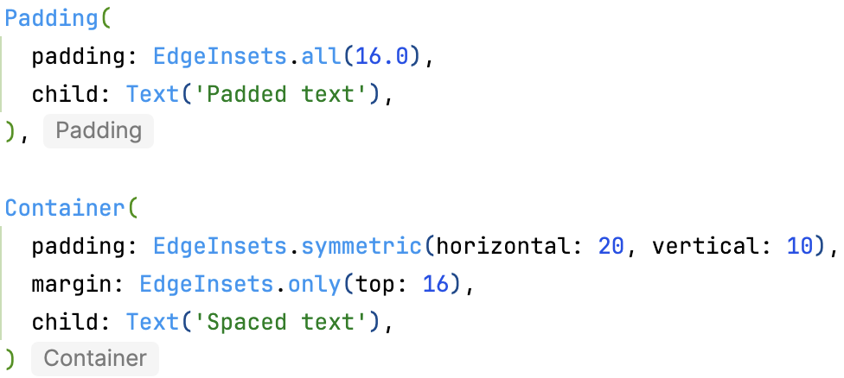
Common Widget Properties – Padding & Margin
Padding: Space inside widget boundaries
Margin: Space outside widget boundaries (Container only)
Use EdgeInsets class:
EdgeInsets.all(value): Same on all sides
EdgeInsets.symmetric(vertical: v, horizontal: h)
EdgeInsets.only(left: l, top: t, right: r, bottom: b)
EdgeInsets.fromLTRB(l, t, r, b)

Slide 33
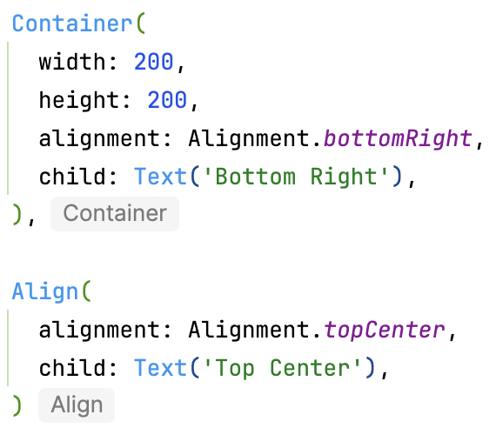
Common Widget Properties – Alignment
Controls widget position within parent
Alignment class constants:
Alignment.topLeft, Alignment.center, Alignment.bottomRight, etc.
Custom: Alignment(x, y) where -1.0 to 1.0
FractionalOffset: 0.0 to 1.0 range

Slide 34
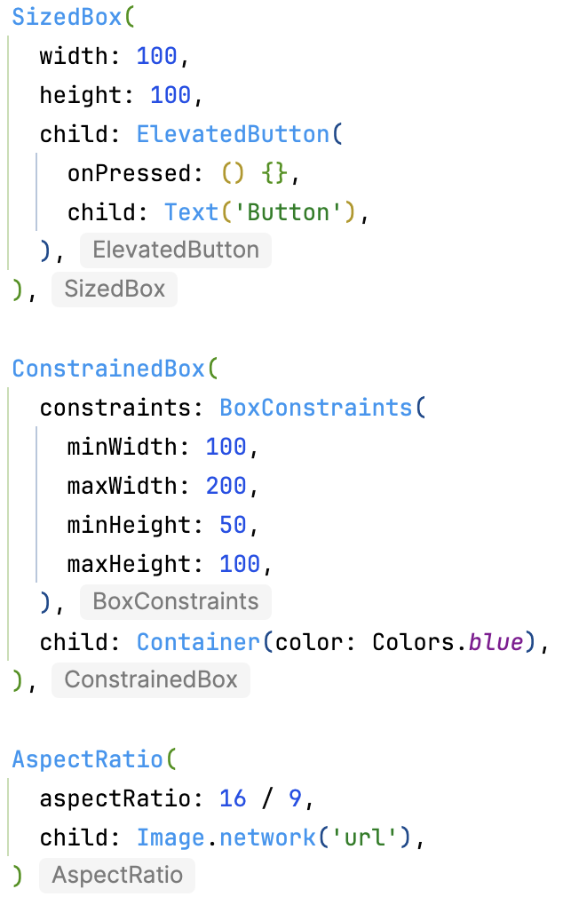
Common Widget Properties – Constraints
Control widget size
SizedBox: Fixed width/height
SizedBox(width: 100, height: 50, child: ...)
SizedBox.shrink(): Zero size
SizedBox.expand(): Fill available space
ConstrainedBox: Min/max constraints
UnconstrainedBox: Remove parent constraints
AspectRatio: Maintain aspect ratio

Slide 35
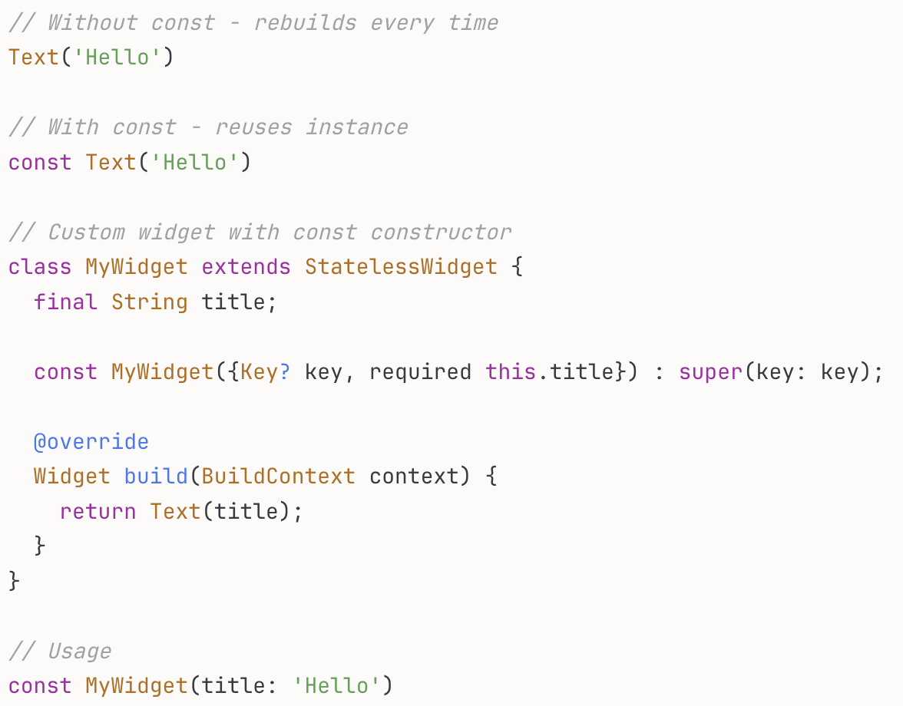
Performance optimizations
Use const keyword when widget never changes
Flutter reuses existing widget instance instead of rebuilding
Significant performance improvement
Rule: If widget has no mutable state, make it const

Slide 36
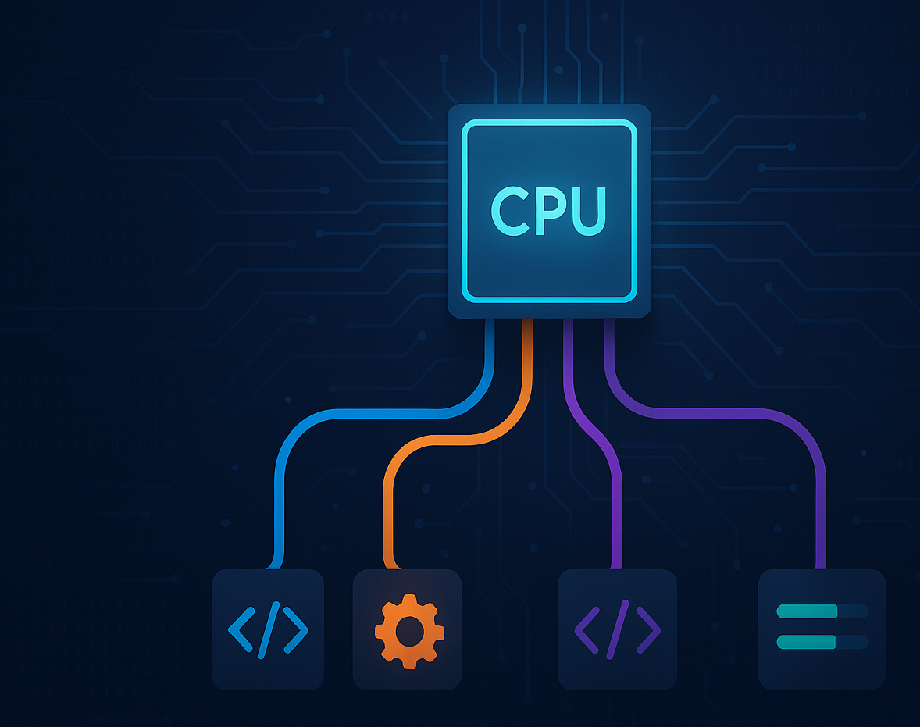
Concurrency

Slide 37
Mobile apps context
Users expect instant responses to every interaction
Apps must remain responsive while performing complex operations
Modern apps handle: network requests, database queries, image processing, complex calculations

Slide 38
The problem
Long-running operations block the app
01
Frozen UI = poor user experience = app uninstalls
02
Mobile devices have limited resources but powerful multi-core processors
03

Slide 39
What is a Thread?
A thread is an independent sequence of execution within a program. Think of it as a worker that can perform tasks.
What is the UI Thread? Every mobile app starts with ONE special thread that handles all UI operations.

Slide 40
Process vs Thread
Process: An entire running application with its own memory space
Thread: A unit of execution within a process
One process can have multiple threads
Threads share the same memory space (heap) but have their own stack

Slide 41
Multithreading Concepts
Concurrent vs Parallel Execution
Concurrent: Tasks making progress by switching rapidly (time-slicing on single core)
Parallel: Tasks literally running at the same time (multiple cores)
Mobile devices have 4-8+ cores → true parallelism is possible

Slide 42
More on the UI Thread
Platform Names
Android: Main Thread or UI Thread
iOS: Main Thread or Main Queue
Flutter: Main Isolate or UI Isolate
Responsibilities
Rendering: Drawing pixels on screen
Event Handling: Processing touch, gestures, keyboard input
View Lifecycle: Creating/destroying UI components
Animations: Smooth transitions and effects

Slide 43
The 16ms rule
60 frames per second (60 FPS)
1 second / 60 frames = 16.67ms per frame
Every 16ms, the UI thread must:
Handle input events
Update view state
Layout components
Draw to screen

Slide 44
What happens for >16ms?
Jank: Dropped frames, stuttery animation
ANR (Android): "Application Not Responding" dialog after 5 seconds
Watchdog (iOS): App killed if unresponsive
Bad Reviews: Users hate frozen apps
Golden Rule: NEVER block the UI thread

Slide 45
Threads vs Async
Threading Model
True Parallelism: Code runs simultaneously on different cores
Separate Execution Contexts: Each has own stack
Shared Memory: All access same heap (synchronization needed)
Higher Overhead: Thread creation, context switching, memory
Asynchronous Model
[Single Thread]: Task A → Task B → Task A → Task C → Task B
Cooperative Multitasking: Tasks voluntarily yield control
Single Thread: No parallelism, but appears concurrent
Event Loop: Manages task scheduling
No Shared State Issues: Everything on same thread
Lower Overhead: No context switching between threads

Slide 46
Async vs Threads
Aspect | Threads | Async
Execution | Parallel (multi-core) | Concurrent (single-core)
Memory | Shared (sync needed) | No sharing issues
Overhead | Higher | Lower
Use Case | CPU-intensive | I/O-bound
Complexity | High (race conditions) | Lower

Slide 47
When to Use Each
Async: Network calls, file I/O, waiting for events (most operations)
Threads/Isolates: Image processing, encryption, heavy computation

Slide 48
Evolution of Async Patterns
Callbacks: doAsync(data, callback)
Callback hell
Promises/Futures: doAsync(data).then(...)
Chainable, better error handling
Async/Await: await doAsync(data)
Looks synchronous, actually async
Best of both worlds

Slide 49
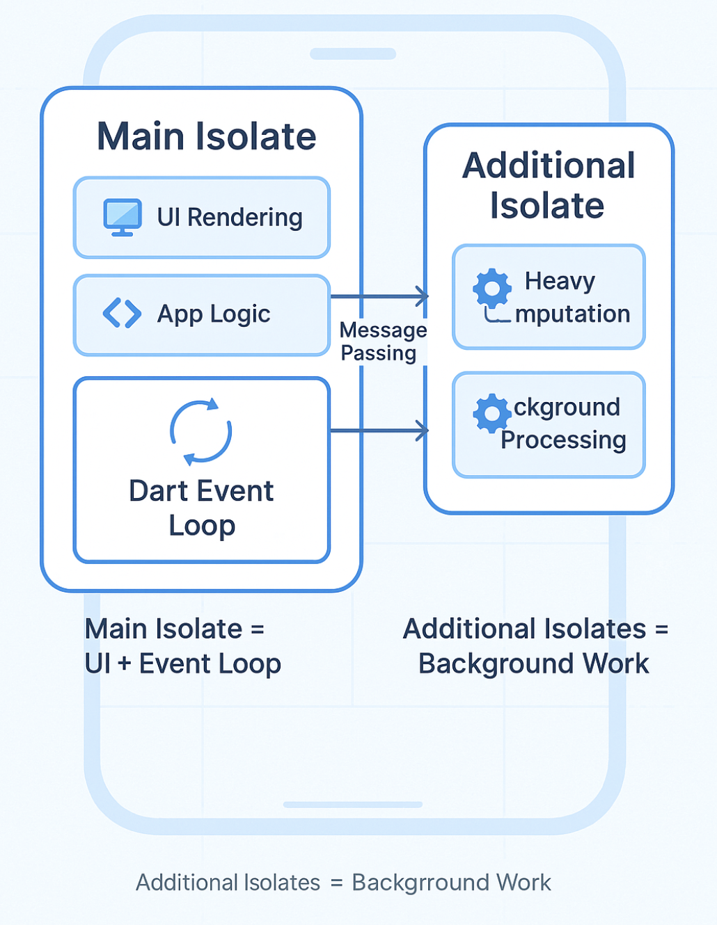
Flutter concurrency model
Architecture
Main Isolate: Runs UI and handles most app logic
Dart Event Loop: Manages async operations on main isolate
Additional Isolates: Spawned for heavy computation

Slide 50
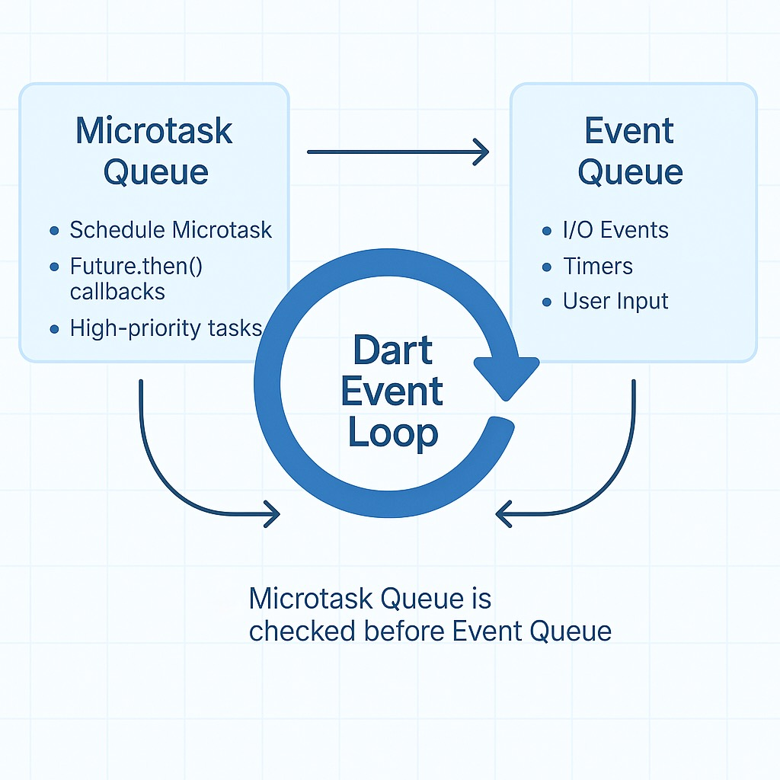
Dart event loop

Slide 51
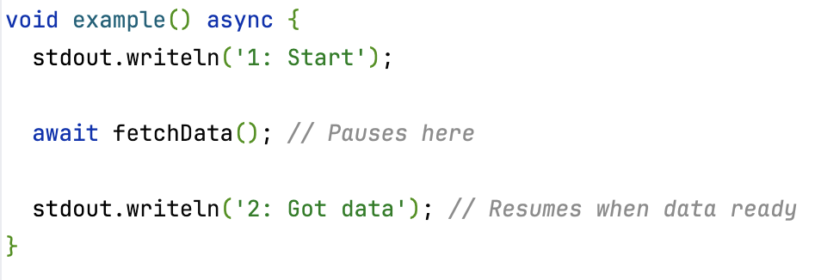
Async / Await in Dart

Slide 52
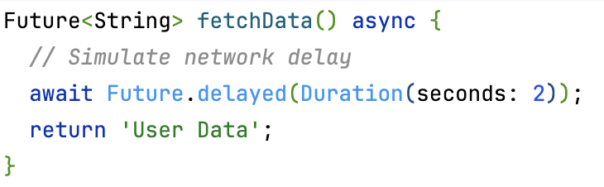
Async / Await in Dart

Slide 53
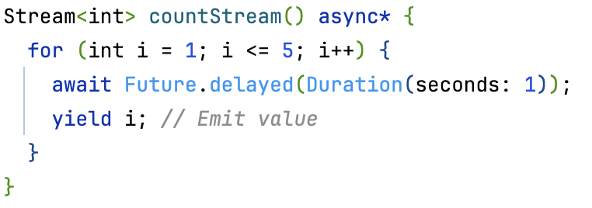
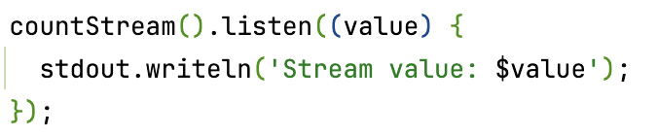
Async / Await in Dart
Future: Represents a value that will be available later
Stream: Multiple values over time

Slide 54
Async Limitation
Async/await is cooperative - code must yield control back to the event loop. CPU-intensive operations don't naturally yield, so they block the entire thread.
Common Blocking Operations
Image Processing: Resizing, filtering, compression
Encryption/Decryption: Large data encoding
Parsing: Large JSON/XML files
Complex Algorithms: Sorting millions of items, pathfinding
Data Compression: Zip/unzip operations
Mathematical Computations: Scientific calculations

Slide 55
Async Limitation
The Solution Move CPU-intensive work to a separate isolate for true parallelism
Rule of Thumb
Operation takes > 100ms of pure CPU time? → Use isolate
Operation waits for I/O (network, disk)? → Use async/await

Slide 56
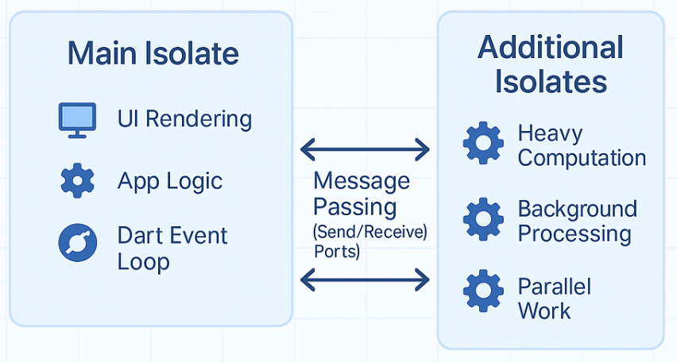
Flutter Isolates
An Isolate is Dart's approach to achieving true parallelism. Think of it as a completely separate "worker" with its own memory.

Slide 57
Flutter Isolates
Isolates cannot share memory
Must communicate by sending messages through ports
Messages are copied (primitive types) or transferred
This eliminates race conditions!

Slide 58
Comparison to Traditional Threads
Feature | Threads (Java/C++) | Isolates (Dart)
Memory | Shared heap | Separate heaps
Communication | Direct access | Message passing
Synchronization | Locks/mutexes needed | Not needed
Race Conditions | Common problem | Impossible
Complexity | High | Medium

Slide 59
Performance Consideration
Creating isolate: ~2-10ms
Sending message: Depends on data size
Small data (< 1MB): Fast copy
Large data: Consider TransferableTypedData

Slide 60
Isolate Limitations & Considerations
Communication Overhead & The Serialization Cost
Cannot Access UI Directly
Limited by CPU Cores (e.g. 4 cores => You should not have more than 4 Isolates)

Slide 61
compute() Function
The compute() function is Flutter's convenience wrapper around isolates for simple, one-off computations.
Creates the isolate
Sends your data
Receives the result
Cleans up the isolate
Handles errors

